Slide 1
IASI-A: End of life tests
IASI CONFERENCE
Evian
06/12/2021
Jérémie Ansart
Laura Le Barbier
Olivier Vandermarcq

Slide 2
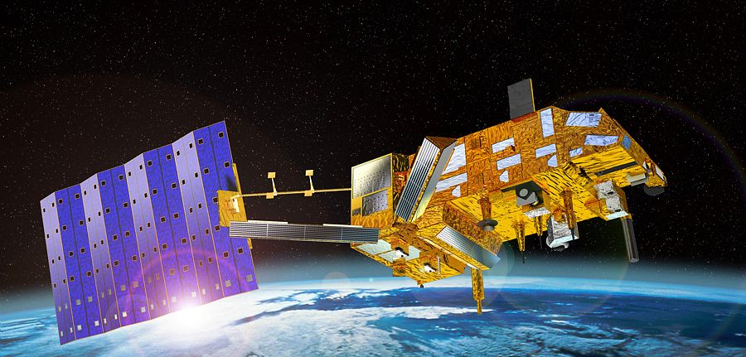
Agenda of the presentation
IASI-A End of life tests – 06/12/2021
IASI-EOL-01: LFD release
IASI-EOL-02: Compensation device stop
IASI-EOL-03: Inter-Calibration of Metop-A, B & C
IASI-EOL-13: IASI redundancies
IASI-EOL-15: Local improvment of spatial sampling
IASI-EOL-16: Investigation on CSQ anomaly
IASI-EOL-17: Deep space manœuvre acquisition
IASI-EOL-18: NEDT improvement in B1 on 1 sounder pixel

Slide 3
Agenda of the presentation
IASI-A End of life tests – 06/12/2021
IASI-EOL-01: LFD release
IASI-EOL-02: Compensation device stop
IASI-EOL-03: Inter-Calibration of Metop-A, B & C
IASI-EOL-13: IASI redundancies
IASI-EOL-15: Local improvment of spatial sampling
IASI-EOL-16: Investigation on CSQ anomaly
IASI-EOL-17: Deep space manœuvre acquisition
IASI-EOL-18: NEDT improvement in B1 on 1 sounder pixel

Slide 4
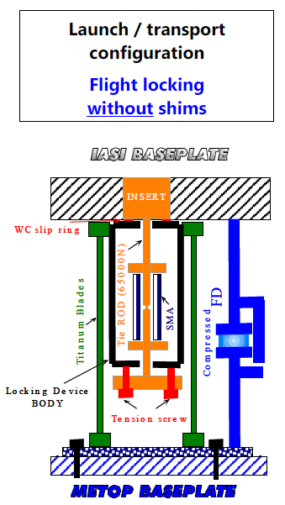
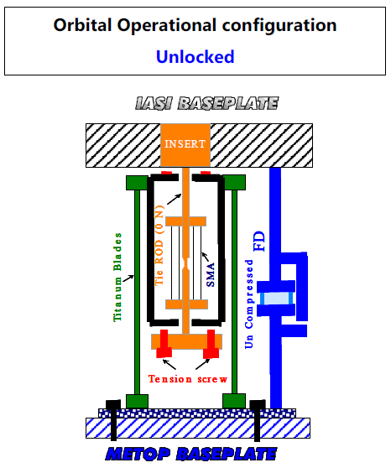
IASI-EOL-1: LFD release ●○○
IASI-A End of life tests – 06/12/2021
Purpose:
Demonstrate that LFDs can be released (after 15 years of compression)
Test the performances with LFD released
Date of test:
Released operation: 02-03 November 2021
Test of the performances: until the end of the mission
Status:
OK
Results:
The 3 LFD SMAs have been successfully unlocked
Temperature plateau observed as expected, showing the phase transition and thus the elongation of the SMA material. There is no more compression force on the 3 filtering devices !

Slide 5
IASI-EOL-1: LFD release ●●○
IASI-A End of life tests – 06/12/2021
Results:
The effectiveness of dimensional recovery of the filtering devices uncompressed cannot be stated, as we have no direct observable.
The filtering devices must recover a sufficient height in order to release a gap between IASI and Metop so as the only mechanical path goes through the filtering device. This is expected to take about a week after the SMA unlock.
As we have no identifiable external source of microvibration perturbation, it is not possible to state whether we really see a microvibration filtering effect.
If complete release is successful, we probably have no effect on the instrument performance.
We did’nt see any effect on the behaviour with CD ON (it was expected because the effect of the LFD released may be not visible before 5 days)
No effect on SCAO side

Slide 6
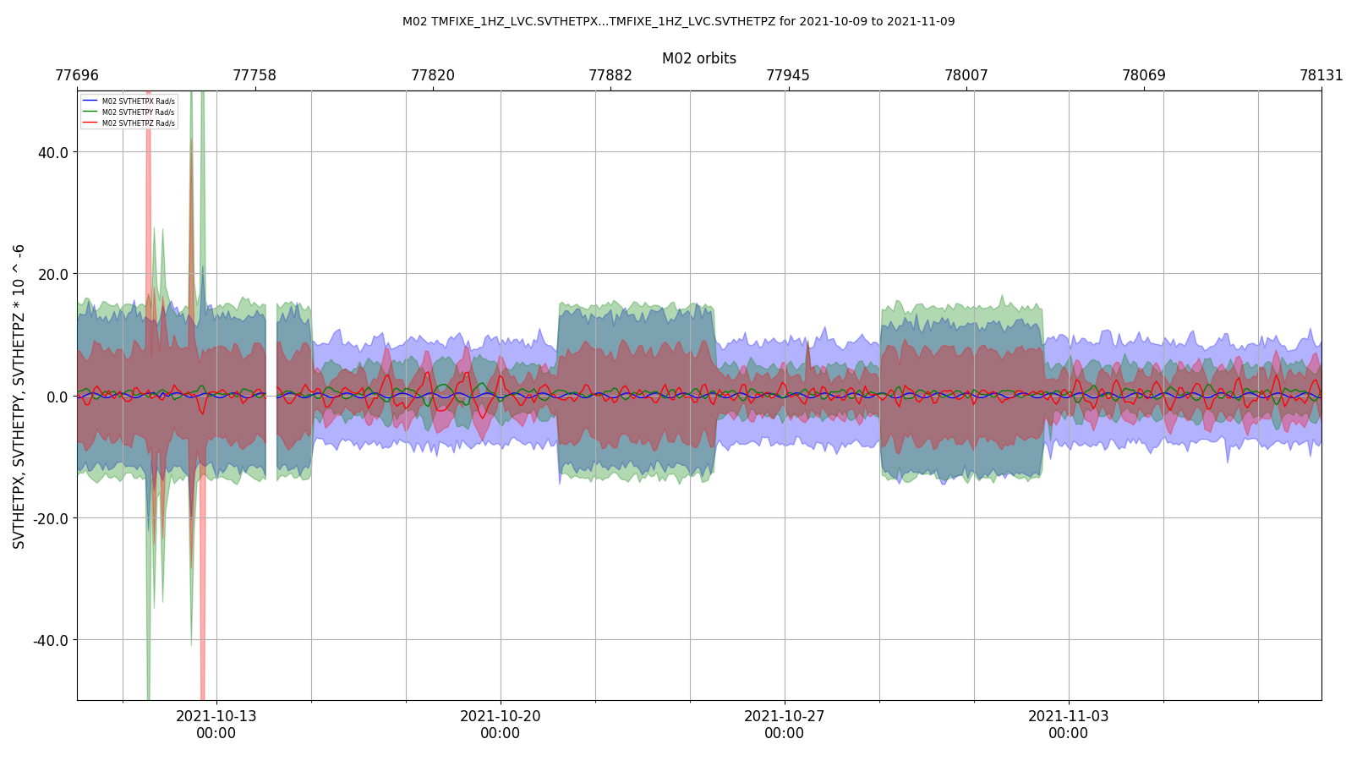
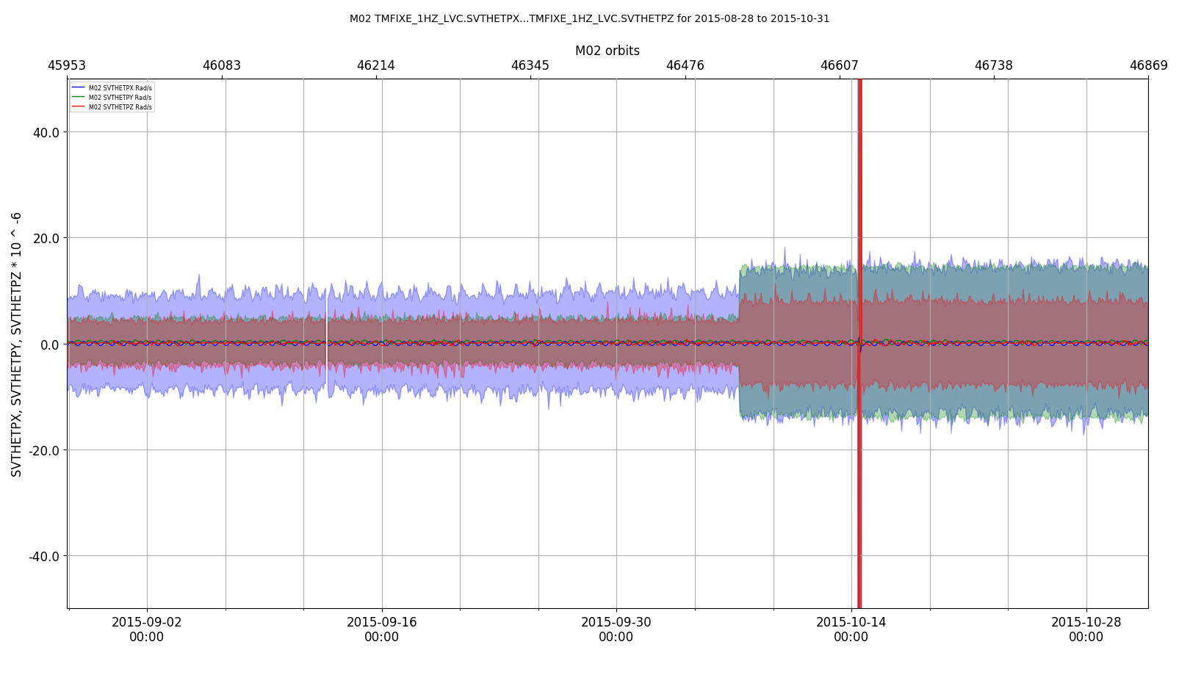
IASI-EOL-1: LFD release ●●●
IASI-A End of life tests – 06/12/2021
No effect on any performances parameters
No effect on the LOS
LFD released
LFD not released
IASI CCFD ON and CD ON
IASI CCFD ON and CD ON
6

Slide 7
Agenda of the presentation
IASI-A End of life tests – 06/12/2021
IASI-EOL-01: LFD release
IASI-EOL-02: Compensation device stop
IASI-EOL-03: Inter-Calibration of Metop-A, B & C
IASI-EOL-13: IASI redundancies
IASI-EOL-15: Local improvment of spatial sampling
IASI-EOL-16: Investigation on CSQ anomaly
IASI-EOL-17: Deep space manœuvre acquisition
IASI-EOL-18: NEDT improvement in B1 on 1 sounder pixel

Slide 8
IASI-EOL-2: Compensation device stop ●○
IASI-A End of life tests – 06/12/2021
Purpose:
Check the data quality and evaluate how the mechanical configuration affects the platform with LFD released
The effect of the LFD released (if any) is expected to be higher with CD OFF
Date of test:
11-14 November 2021
Status:
OK
Results:
No effect on the LOS: we can expect that the LFD released is completed

Slide 9
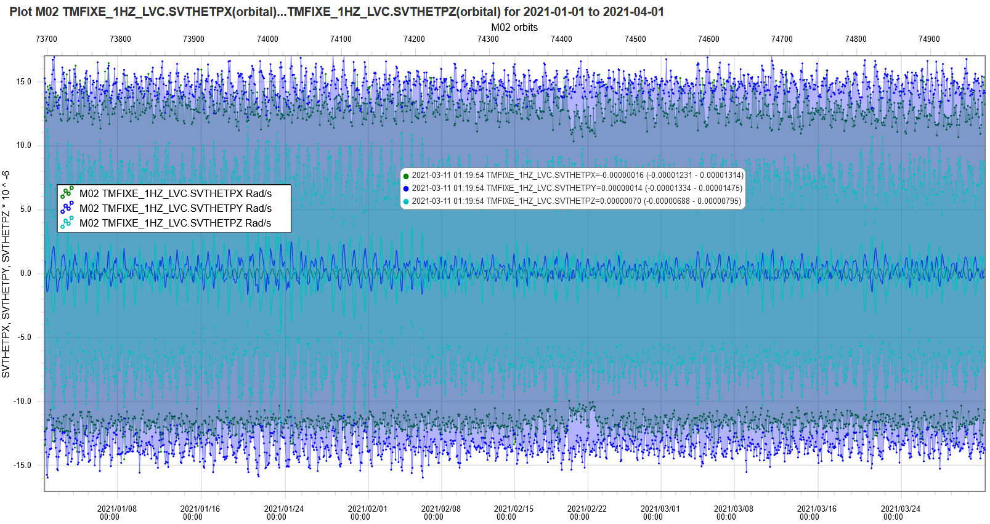
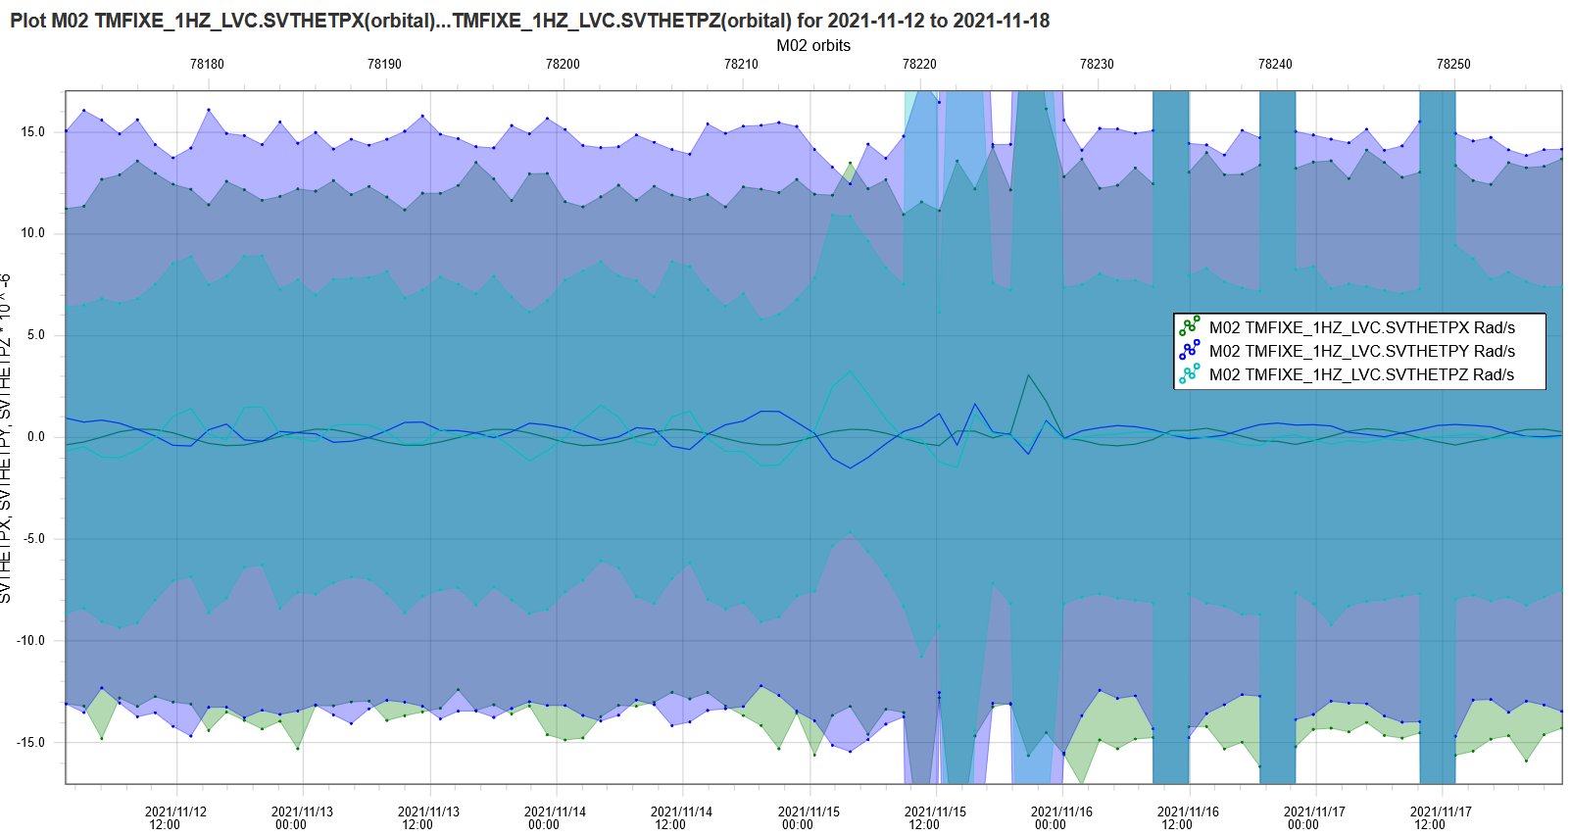
IASI-EOL-2: Compensation device stop ●●
IASI-A End of life tests – 06/12/2021
No effect seen on SCAO side
No effect on any performances parameters: two hypotesis can be done:
The interface between IASI and Metop is still rigid because of the ageing of the elastomere
The CD is not as useful as expected
LFD release

Slide 10
Agenda of the presentation
IASI-A End of life tests – 06/12/2021
IASI-EOL-01: LFD release
IASI-EOL-02: Compensation device stop
IASI-EOL-03: Inter-Calibration of Metop-A, B & C
IASI-EOL-13: IASI redundancies
IASI-EOL-15: Local improvment of spatial sampling and spatial resolution
IASI-EOL-16: Investigation on CSQ anomaly
IASI-EOL-17: Deep space manœuvre acquisition
IASI-EOL-18: NEDT improvement in B1 on 1 sounder pixel

Slide 11
IASI-EOL-03: Intercalibration of Metop-A, B & C●○
IASI-A End of life tests – 06/12/2021
Purpose:
Intercalibration of IASI-A,B and C using simultaneous observations
Process:
Taking advantage of the modification of IASI-A orbit to have simultaneous observations with IASI-B and C
Date of test:
16 -26 November
Status:
OK
Results:
The data must be analysed

Slide 12
Agenda of the presentation
IASI-A End of life tests – 06/12/2021
IASI-EOL-01: LFD release
IASI-EOL-02: Compensation device stop
IASI-EOL-03: Inter-Calibration of Metop-A, B & C
IASI-EOL-13: IASI redundancies
IASI-EOL-15: Local improvment of spatial sampling
IASI-EOL-16: Investigation on CSQ anomaly
IASI-EOL-17: Deep space manœuvre acquisition
IASI-EOL-18: NEDT improvement in B1 on 1 sounder pixel

Slide 13
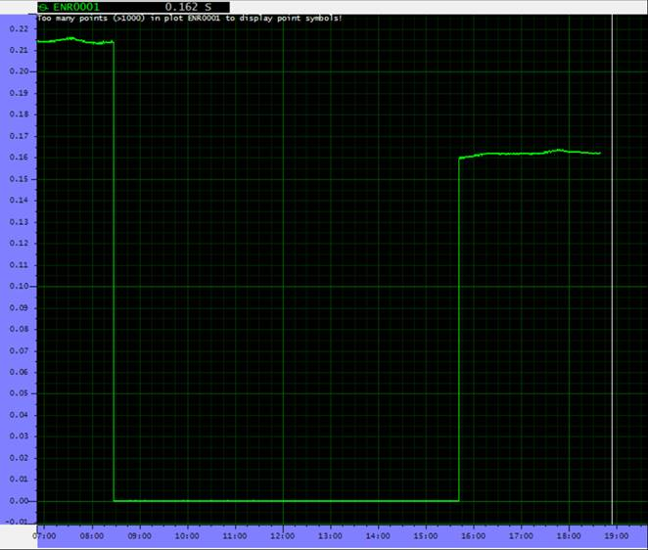
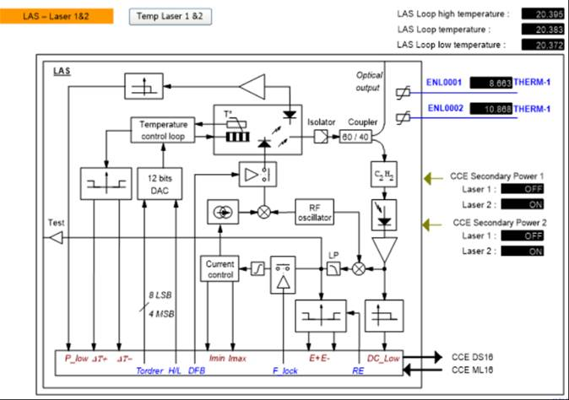
IASI-EOL-13: IASI redundancies ●○
IASI-A End of life tests – 06/12/2021
Purpose:
Test the instrument redundancies:
Instrument Side-B and Laser 2
Instrument Side-B and DPC-5
Date of test:
6 September 2021
Status:
OK
Results:
Laser 2 turn on successfully with a power similar to the
laser 1 (compatible with nominal performances)
Laser 1
Laser 2
Power Level for nominal performances
Power of the laser

Slide 14
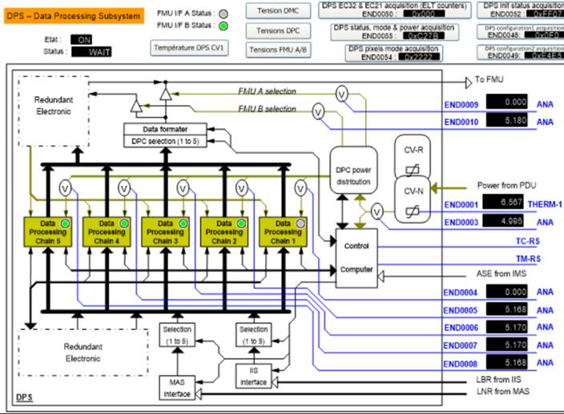
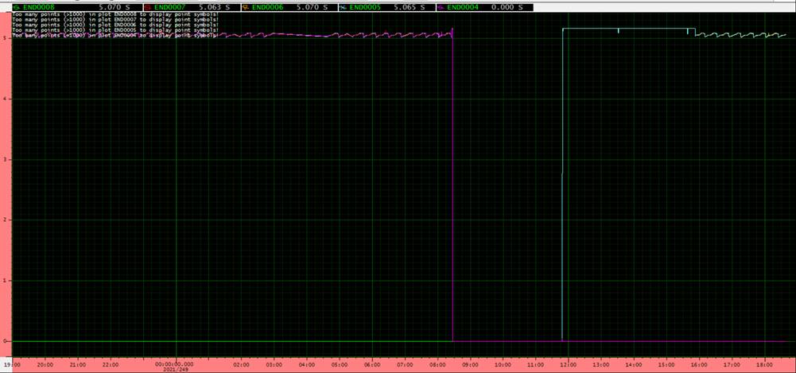
IASI-EOL-13: IASI redundancies ●●
IASI-A End of life tests – 06/12/2021
Results:
DPC5 turn on successfully (and DP1 OFF)
Data production successful on DPC-5
Power consumption of the DPCs
DPC-1 on
DPC-1 off
DPC-1
turned off
DPC-5
turned on

Slide 15
Agenda of the presentation
IASI-A End of life tests – 06/12/2021
IASI-EOL-01: LFD release
IASI-EOL-02: Compensation device stop
IASI-EOL-03: Inter-Calibration of Metop-A, B & C
IASI-EOL-13: IASI redundancies
IASI-EOL-15: Local improvment of spatial sampling
IASI-EOL-16: Investigation on CSQ anomaly
IASI-EOL-17: Deep space manœuvre acquisition
IASI-EOL-18: NEDT improvement in B1 on 1 sounder pixel

Slide 16
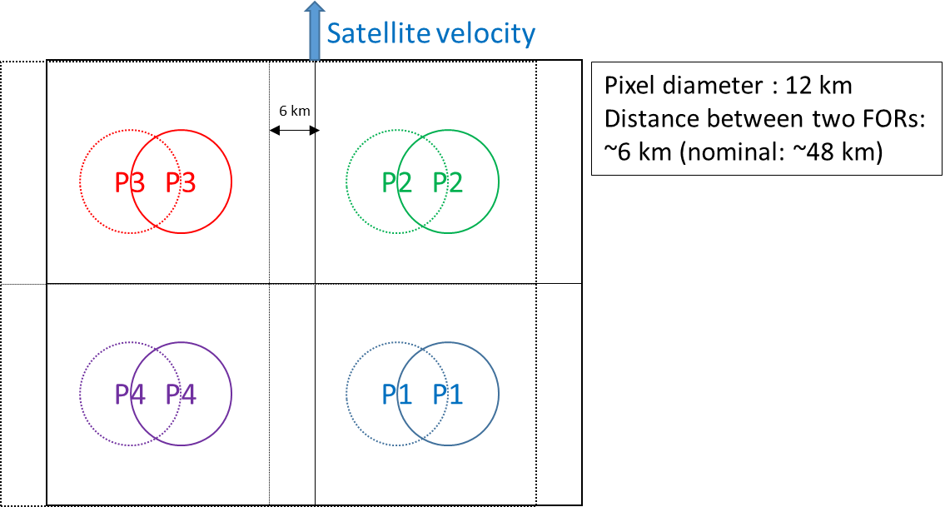
IASI-EOL-15: Local improvment of spatial sampling ●○
IASI-A End of life tests – 06/12/2021
Purpose:
Increase the spatial sampling
Process:
Modification of the scanning law parameters: dividing by ~8 the spacing between two views (from 58.178 mrad to 7.3 mrad)
Date of test:
16 September 2021 and during 29 days
Status:
OK
Results:
The data have been correctly acquired during the 29 days

Slide 17
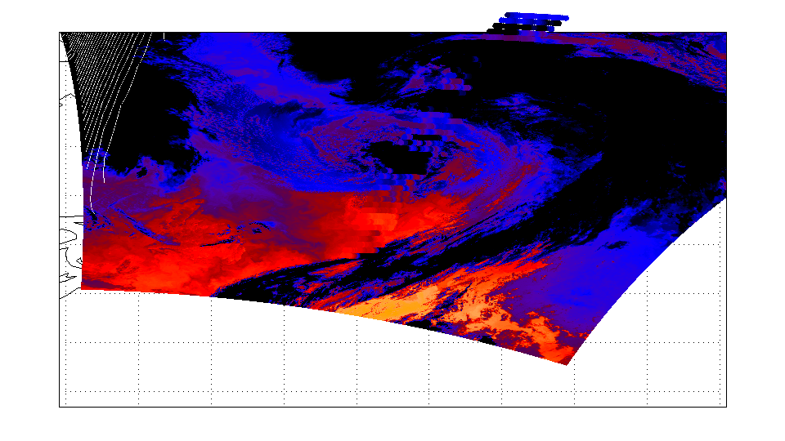
IASI-EOL-15: Local improvment of spatial sampling ●●
IASI-A End of life tests – 06/12/2021
Scientific interests:
Oversampling area of interest : atmospheric chemistry, pollution
Impact of overlapping pixel on the retrievals: preparation of MTG-IRS
Noise reduction : preparation of IASI-NG
Thanks Bertrand
We are waiting for users feedbacks

Slide 18
Agenda of the presentation
IASI-A End of life tests – 06/12/2021
IASI-EOL-01: LFD release
IASI-EOL-02: Compensation device stop
IASI-EOL-03: Inter-Calibration of Metop-A, B & C
IASI-EOL-13: IASI redundancies
IASI-EOL-15: Local improvment of spatial sampling
IASI-EOL-16: Investigation on CSQ anomaly
IASI-EOL-17: Deep space manœuvre acquisition
IASI-EOL-18: NEDT improvement in B1 on 1 sounder pixel

Slide 19
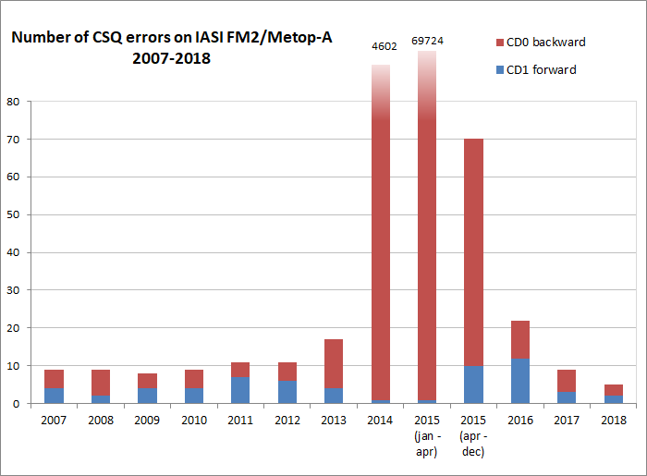
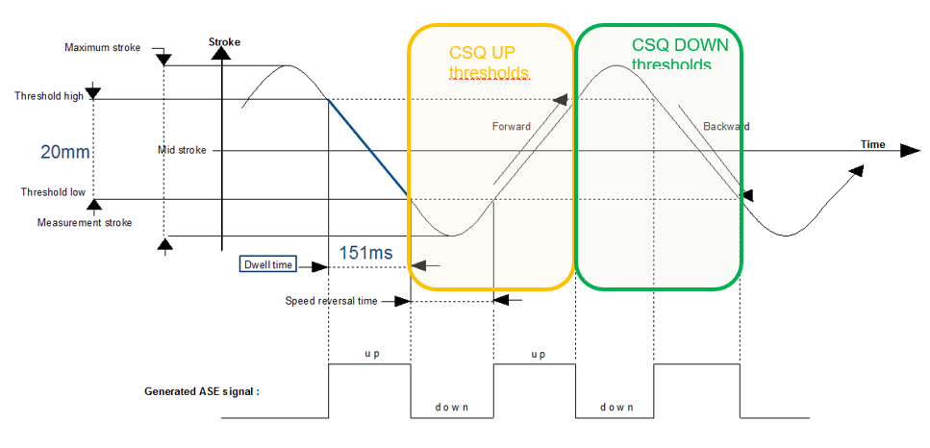
IASI-EOL-16: Investigation on CSQ anomaly ●○
IASI-A End of life tests – 06/12/2021
Purpose:
To characterize more finely the CSQ anomalies on nominal side and redundant side, via modifications of CSQ thresholds
Process:
We modified step by step the CSQ threshold on each
side for the sens forward and backward
Date of test:
7-13 and 25-29 October 2021
Status:
OK for side B
NOK for side A
Side A
Side B
Avril 2015 passage redondant

Slide 20
IASI-EOL-16: Investigation on CSQ anomaly ●●
IASI-A End of life tests – 06/12/2021
Results:
No results on side A because of 1 mistakes and 1 anomaly…
The test on side B give the following results:
We know now that we were closed to the threshold of an anomly behaviour on side B
The behaviour is not the same for Forward and Backward (as seen during the anomaly)
We are able to change the CSQ threshold on board if necessary

Slide 21
Agenda of the presentation
IASI-A End of life tests – 06/12/2021
IASI-EOL-01: LFD release
IASI-EOL-02: Compensation device stop
IASI-EOL-03: Inter-Calibration of Metop-A, B & C
IASI-EOL-13: IASI redundancies
IASI-EOL-15: Local improvment of spatial sampling
IASI-EOL-16: Investigation on CSQ anomaly
IASI-EOL-17: Deep space manœuvre acquisition
IASI-EOL-18: NEDT improvement in B1 on 1 sounder pixel

Slide 22
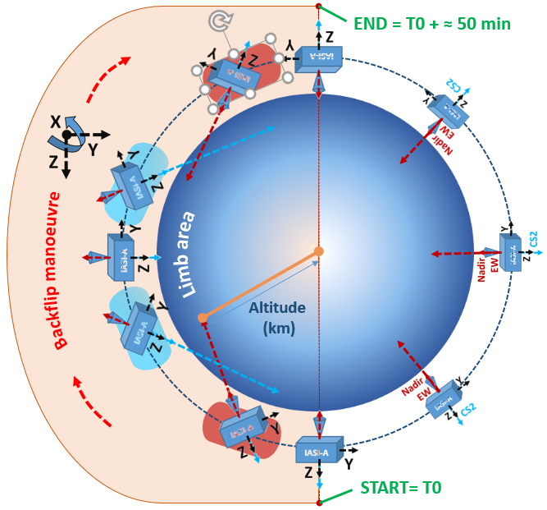
IASI-EOL-17: Deep space manœuvre acquisition ●○
IASI-A End of life tests – 06/12/2021
Purpose:
Performing limb measurments with IASI between
the stratosphere (≈ 25km) to the mesopause (≈ 85km) during
a backflip manœuvre
Process:
Alternatively using Nadir view and CS2
view in order to see the limb area as long as possible
Development of a dedicated external calibration and coding
table for the test
Reprocessing might be necessary
Performed comparison with MIPAS measurements
on ENVISAT
METOP-A timeline position for CS2 Limb measurements
METOP-A timeline position for Nadir EW Limb measurements

Slide 23
IASI-EOL-17: Deep space manœuvre acquisition ●●
IASI-A End of life tests – 06/12/2021
Date of test:
27/11/2021 during 50 min
Status:
Backflip manœuvre successfully done
Data acquired
Results:
We see an augmentation of the detectors temperatures: the performances may be worst than usual
The processing of the data is just starting
=> L1 data verification and reprocessing on CNES side plan until May 2022

Slide 24
Agenda of the presentation
IASI-A End of life tests – 06/12/2021
IASI-EOL-01: LFD release
IASI-EOL-02: Compensation device stop
IASI-EOL-03: Inter-Calibration of Metop-A, B & C
IASI-EOL-13: IASI redundancies
IASI-EOL-15: Local improvment of spatial sampling
IASI-EOL-16: Investigation on CSQ anomaly
IASI-EOL-17: Deep space manœuvre acquisition
IASI-EOL-18: NEDT improvement in B1 on 1 sounder pixel

Slide 25
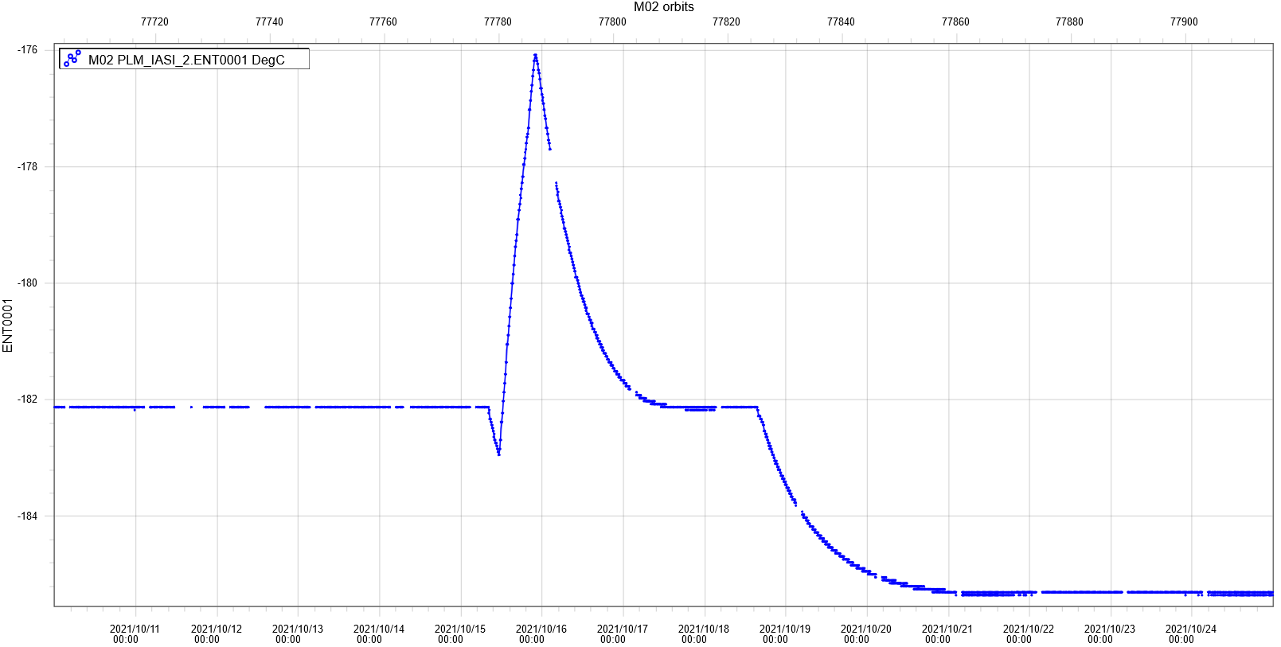
IASI-EOL-18: NEDT improvment in B1 on 1 sounder pixel ●○
IASI-A End of life tests – 06/12/2021
Purpose:
Improve the radiometric noise performance in spectral band B1 for one of the four IASI sounder pixels, by switching off the 3 other pixels which allows to decrease the detectors temperature.
Date of test:
15-24 October and 27-31 October
Status:
OK
Results:
As planned the temperature
of the remaining pixel has lost a bit more
than 3 degreas
Focal Plane temperature
Stabilised temperature with 4 pixels: -182.12 °C
Stabilised temperature with 1 pixels: -185.3 °C

Slide 26
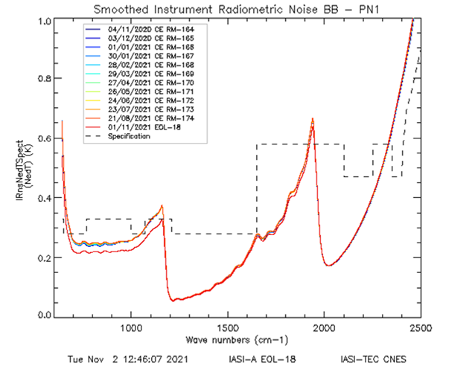
IASI-EOL-18: NEDT improvment in B1 on 1 sounder pixel ●●
IASI-A End of life tests – 06/12/2021
Results:
The decrease of the temperature has allowed an improvment of the NEDT on B1
We only have L0 data because we can’t calculate the interferometric axis with only one pixel
A lot of data available if you are interested in !

Slide 27
IASI-A End of life tests – 06/12/2021
THANK YOU
FOR YOUR ATTENTION !

